Slide 1

Machine learning using Spark
SUBMITTED BY:
PRAGATI DEBATA-A21022

Slide 2
Research Objective:
To discover the clusters of Uber data based on the longitude and latitude, then we will analyze the cluster centers by date/time.
Cluster analysis or clustering is the task of grouping a set of objects in such a way that objects in the same group are more like each other than to those in other groups.

Slide 3

Importance of our Objective:
In today's world the connectivity is a cakewalk. The cab system has reached heights and generated a huge data left to analyze.
Deep diving into this data we will explore:
Which hours of the day and which cluster had the highest number of pickups?
How many pickups occurred in each cluster?
How many pickups occurred in each hour?

Slide 4
Approach:
Creating the spark environment
Loading the required libraries
Understanding the dataset
Data Exploration
Applying various models and predictions

Slide 5
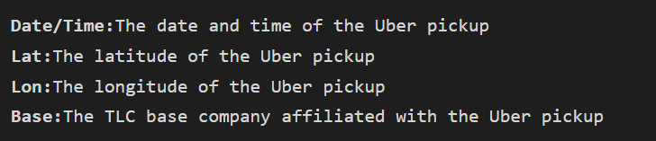
Understanding the Data Set
Our data is Uber trip data from http://data.beta.nyc/dataset/uber-trip-data-foiled-apr-sep-2014.

Slide 6

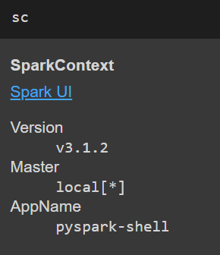
The Coding Part:
To initiate the spark environment in colab we will first need to install JAVA.
Creating the spark session

Slide 7
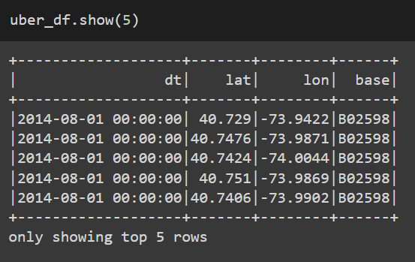
Loading the data:
First, we need to import all the libraries.
Our data is Uber trip data from http://data.beta.nyc/dataset/uber-trip-data-foiled-apr-sep-2014.

Slide 8
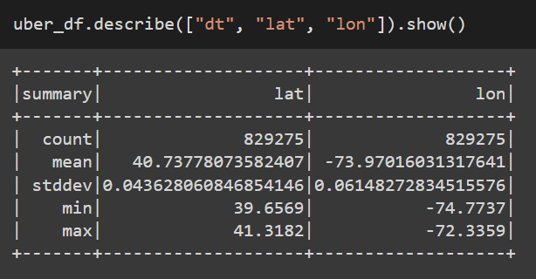
Statistics Summary:
Spark DataFrames include some built-in functions for statistical processing.
The describe() function performs summary statistics calculations on all numeric columns and returns them as a DataFrame.

Slide 9
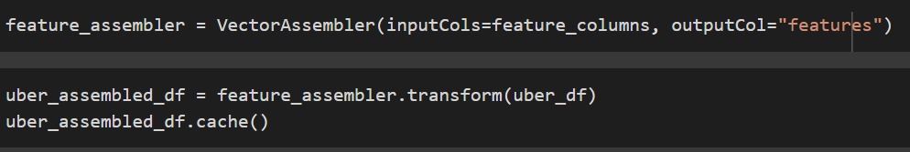
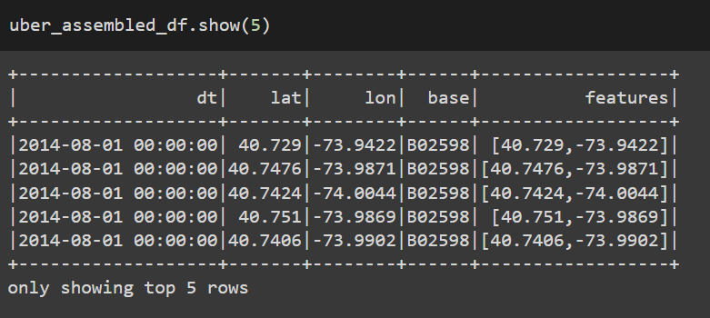
Split into Training and Testing Set:
The train-test split procedure is used to estimate the performance of machine learning algorithms when they are used to make predictions on data not used to train the model.
Before splitting we will vectorize the columns.

Slide 10
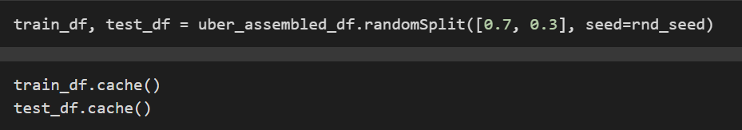
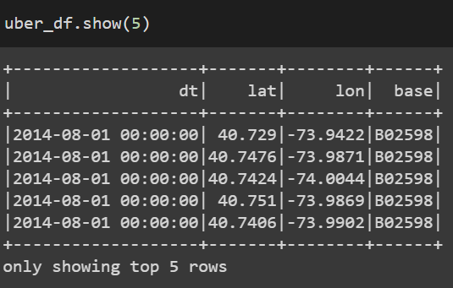

Continued:
Removing the unnecessary data frames

Slide 11
MODELS

Slide 12
K-Means Clustering
k-means is one of the most popular clustering algorithms. In this algorithm, a user-specified number of clusters (k) are randomly assigned to different points in the dataset.
Choosing the right value for k is an extremely important aspect of using this algorithm successfully. There is no real prescription for the number of clusters you need, so we will likely have to experiment with different values and consider what we would like the end result to be.

Slide 13

Importing libraries:
K-means is one of the most used clustering algorithms that clusters the data points into a predefined number of clusters.
K-means is implemented as an estimator and generates a KMeansModel as the base model.

Slide 14
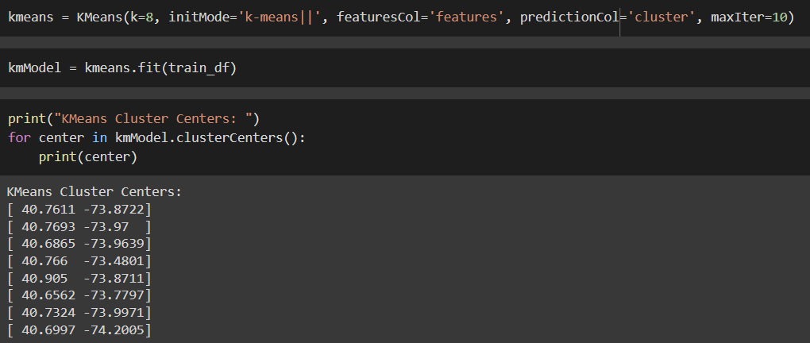
Training and fitting the Model

Slide 15
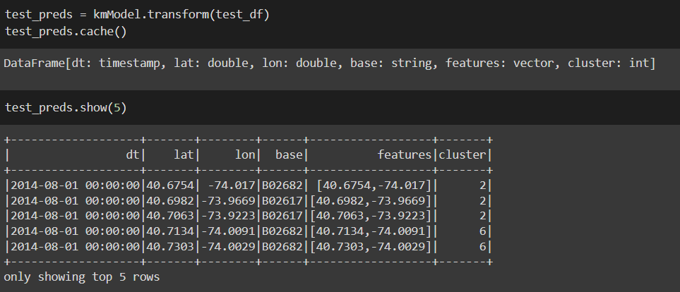
Predictions
As said earlier, we will be predicting clusters based on longitude and latitude columns of our dataset.
The picture shows the different clusters that have been assigned.

Slide 16

Summary:
k-means includes a summary class that we can use to evaluate our model. This class provides some common measures for k-means success. The k-means summary includes information about the clusters created.

Slide 17
Gaussian Mixture Models
Gaussian mixture models (GMM) are another clustering algorithm that try to group data by reducing the sum of squared distances from the center of the cluster.
Gaussian mixture models assume that each cluster produces data based upon random draws from a Gaussian distribution.
A Gaussian mixture model is a probabilistic model that assumes all the data points are generated from a mixture of a finite number of Gaussian distributions with unknown parameters. One can think of mixture models as generalizing k-means clustering to incorporate information about the covariance structure of the data as well as the centers of the latent Gaussians

Slide 18
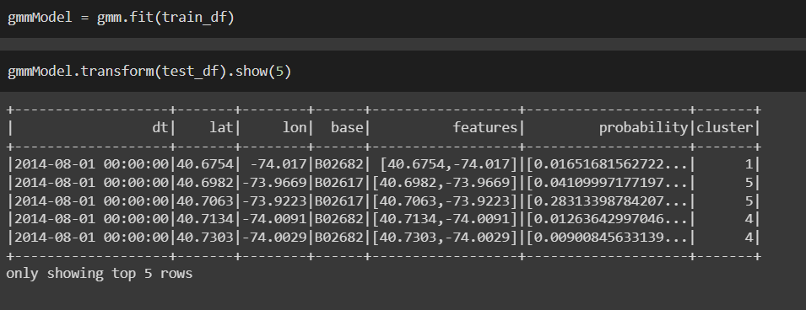
Fitting and testing the model:
The picture shows the different clusters that have been assigned.

Slide 19
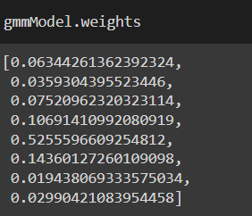
Summary:
Like our k-means clustering algorithm, Gaussian mixture models include a summary class to help with model evaluation. This includes information about the clusters created, like the weights, the means, and the covariance of the Gaussian mixture, which can help us learn more about the underlying structure inside of our data

Slide 20
LET’S ANSWER FEW QUESTIONS

Slide 21
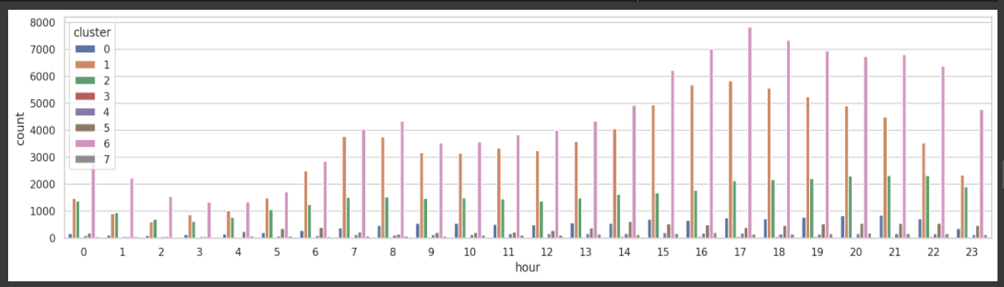
Which hours of the day and which cluster had the highest number of pickups?

Slide 22
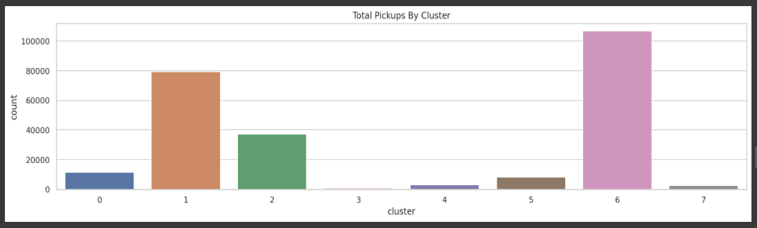
How many pickups occurred in each cluster?

Slide 23
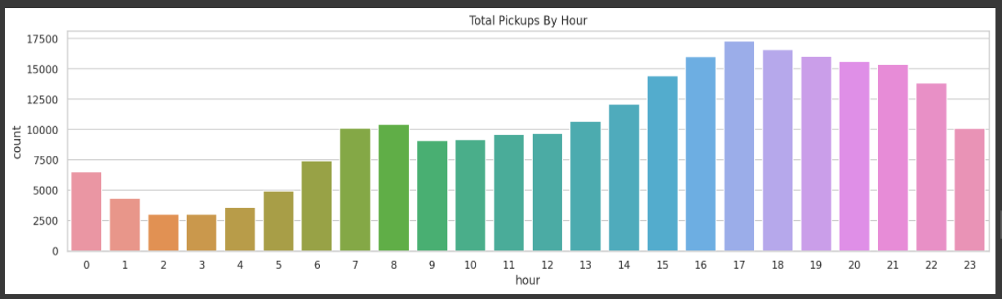
How many pickups occurred in each hour?

Slide 24

Thank you

